Slide 1


ECEN 404 Final Presentation Team 27 Financial Advisor App
for Students Camille Embree, Hoang-Nghi Nguyen TA: Sabyasachi Gupta

Slide 2

Project Summary
Financial management is difficult for many students, with irregular income, high living expenses and a general lack of tools and the incentive to provide clear visibility on personal spending.
Our app addresses this by using AI and machine learning to work with transaction tracking through categorization and personalized financial feedback.

Slide 3
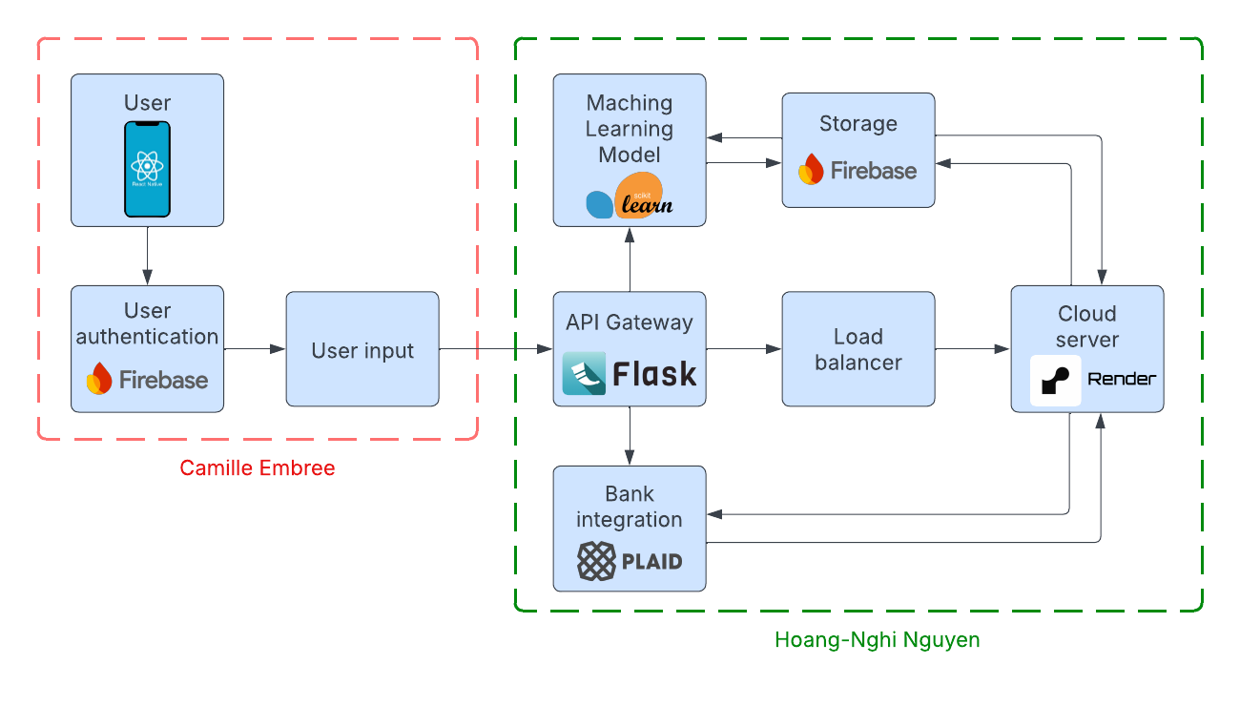
Project/Subsystem Overview

Slide 4
Frontend
Camille Embree
Designed, researched, and verified UI screen pages including a sign in, home, analysis, game, and settings page.
Set up Firebase structures such as Firestore Database and User Authentication
Created API connection with the backend, allowing ML data to be displayed for specific users.

Slide 5
Backend
Hoang-Nghi Nguyen
Designed minigame functions and structures to create the backbone for a good user experience.
Created the structure for analytics diagrams on the home page to display to users their spending patterns and analyses.
Applied ML algorithms to predict user spending and projected user spending outputted through personalized generated feedback after games are completed.
Some issues with analytics outputs: pie chart showing unnamed categories.

Slide 6
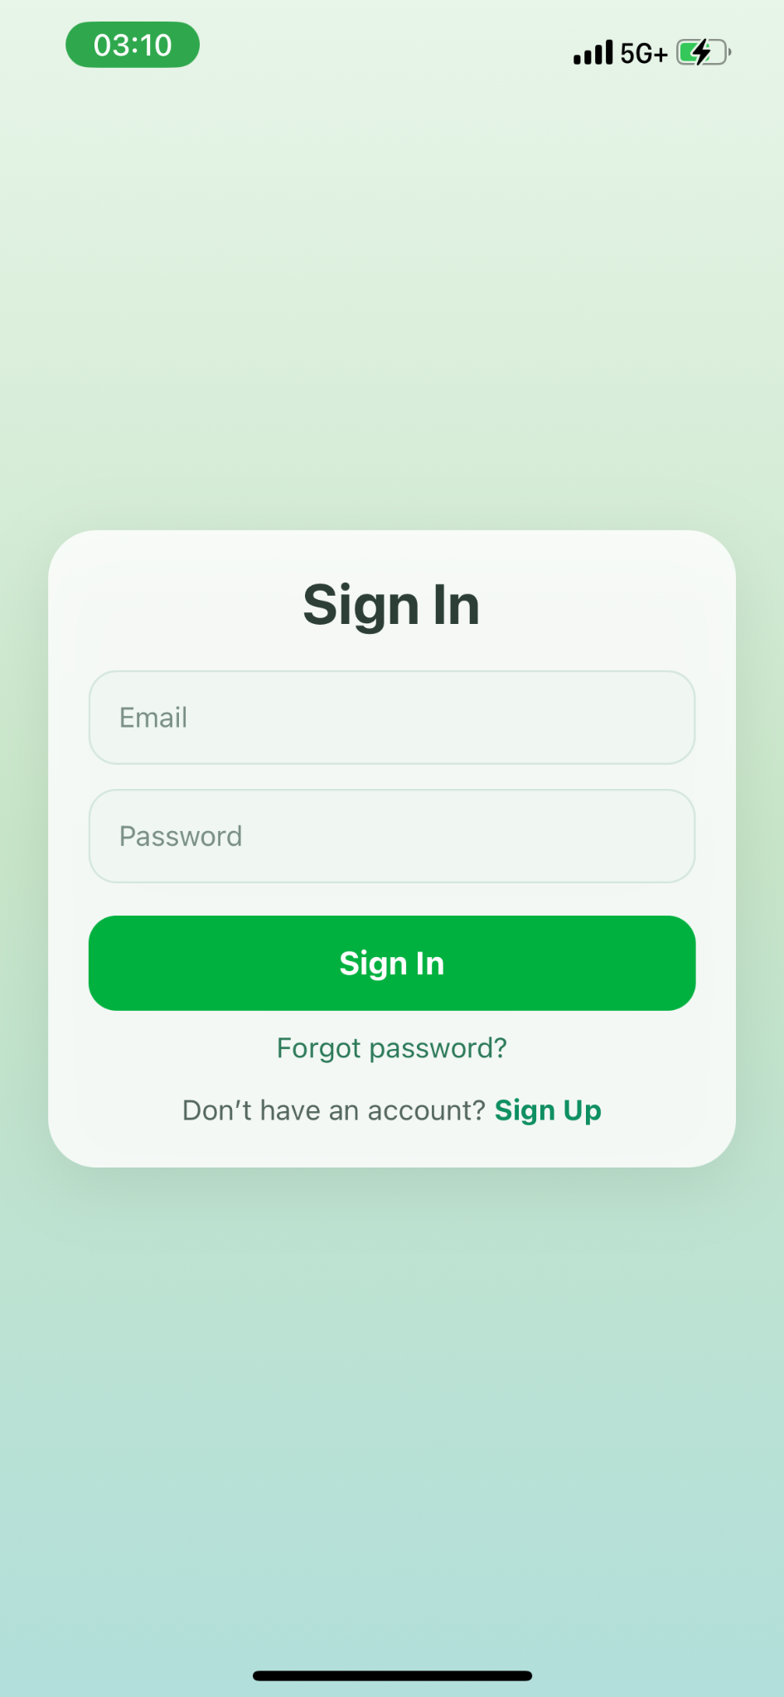
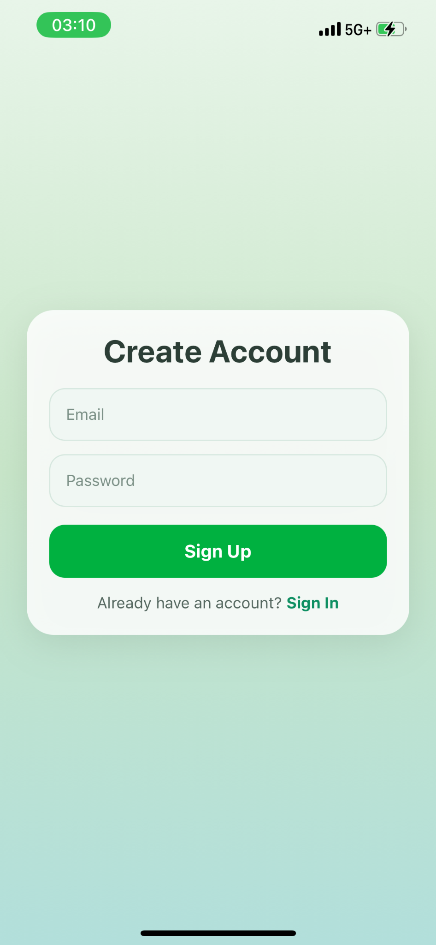
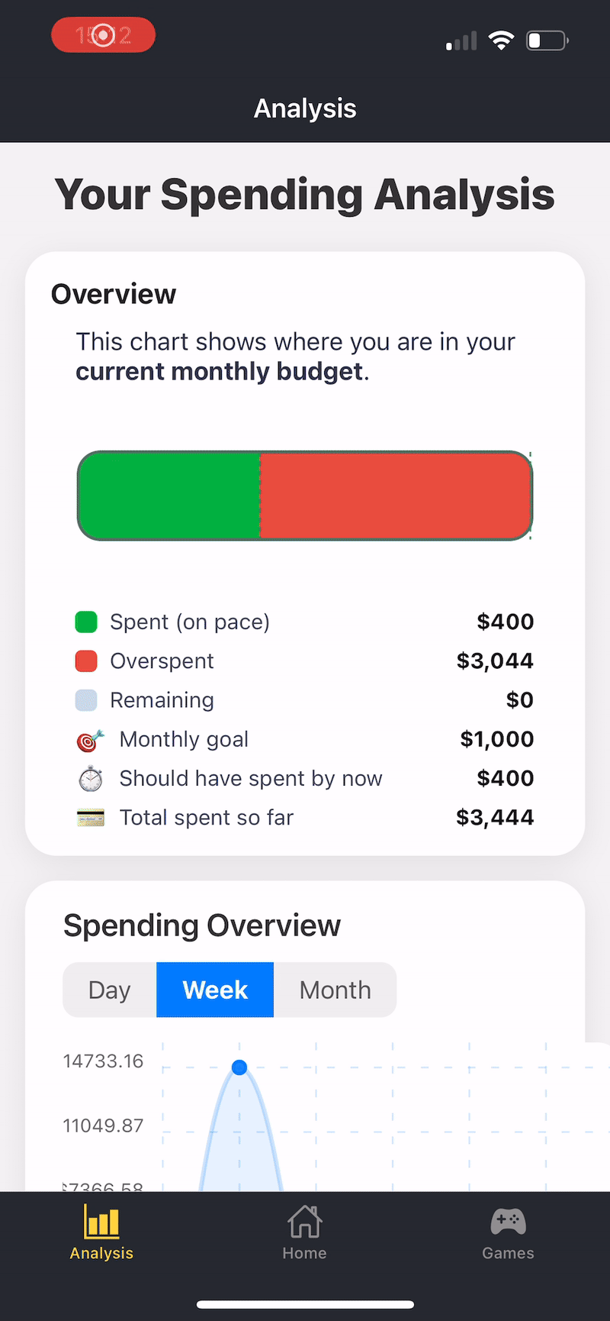
Analysis and Login Integration

Slide 7
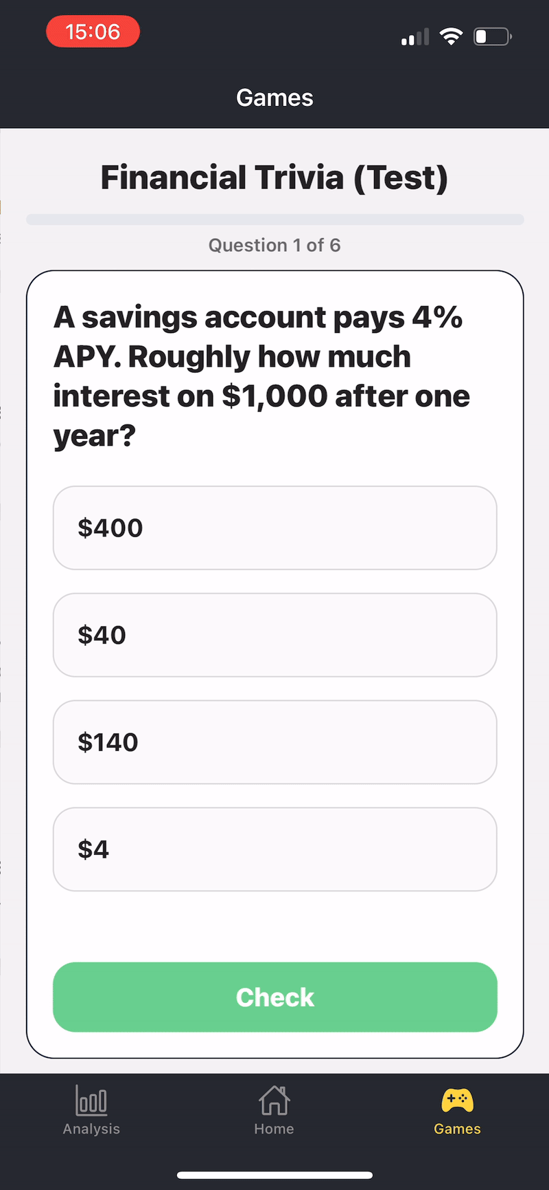
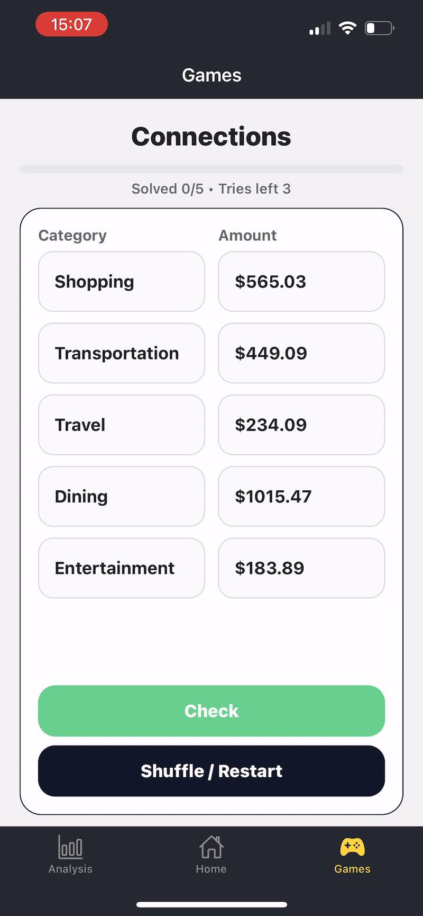
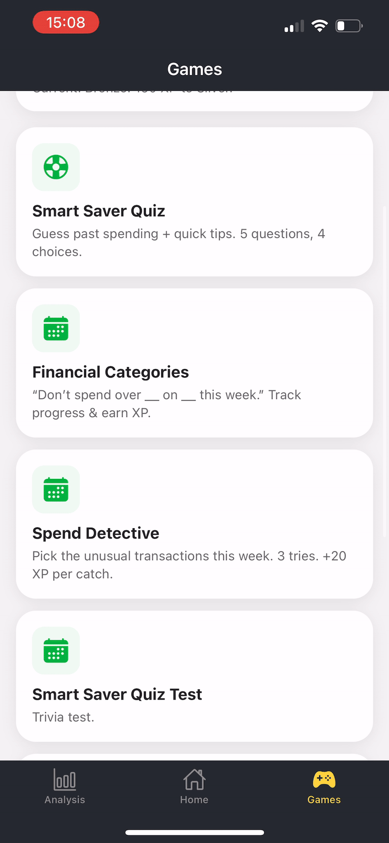
Minigame Integration Results

Slide 8
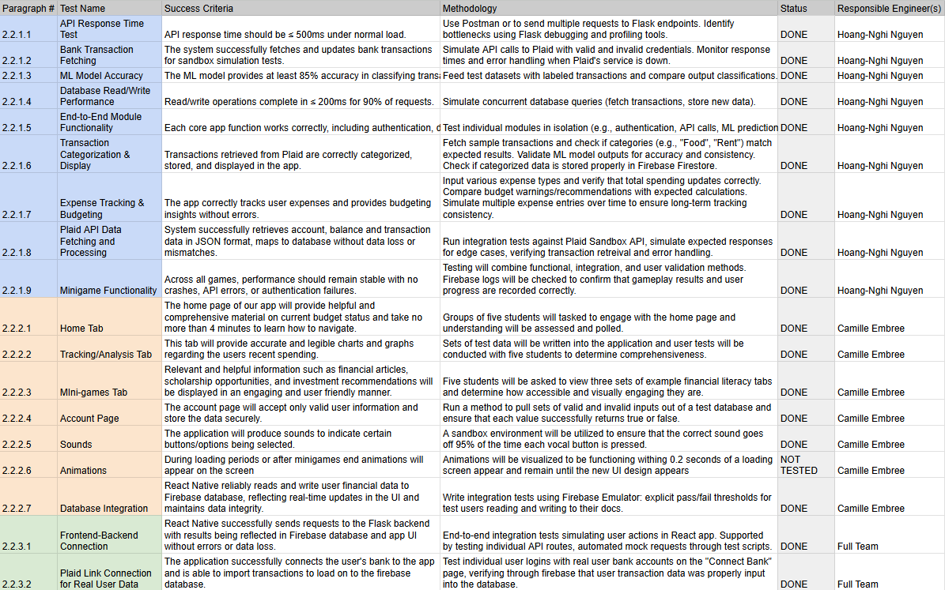
Validation

Slide 9
Conclusions
Made changes to app design to increase design merit and overall app novelty through adaptive gamified learning. Updated on ConOps and FSR/ICD.
Current status: Plaid Link providing issues in regards to bank connection.

Slide 10
Security
1. Firebase Authentication Layer
Industry-standard authentication protocols with end-to-end encryption via HTTPS/TLS
Email verification system for additional account security
Password encryption and secure reset functionality
Each user gets unique user ID for isolated data access
2. Token & Data Encryption
Plaid access tokens are encrypted at rest using Fernet cryptography (symmetric encryption)
All credentials and tokens encrypted within Firebase data centers
Encryption key managed via environment variables (never hardcoded)
3. Protected API Endpoints
require_auth middleware on all sensitive endpoints (Plaid, analytics)
Firebase ID token verification before processing any requests
Users can only access their own data - enforced at both authentication and Firestore rules level
4. Secure External Integrations
Plaid API integration follows OAuth standards for bank connections
Access tokens never exposed to frontend - stored encrypted in backend
Bank credentials never touch our servers (handled by Plaid)

